Slide 1
Matrix equation
Assignment week- 27-7-21
Model - SDGVM
Submitted by - Aneesh Chandel

Slide 2
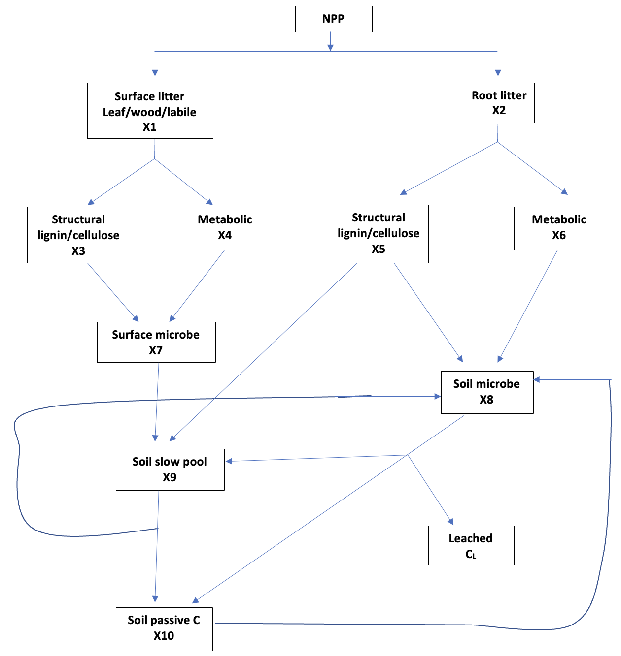
C flow diagram
Reference- Dr. Anthony Walker

Slide 3
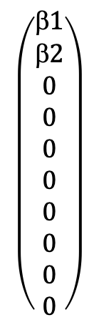
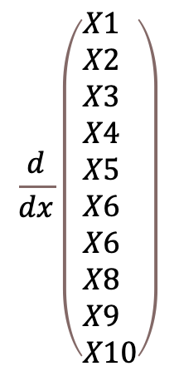
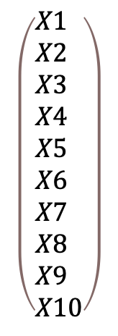
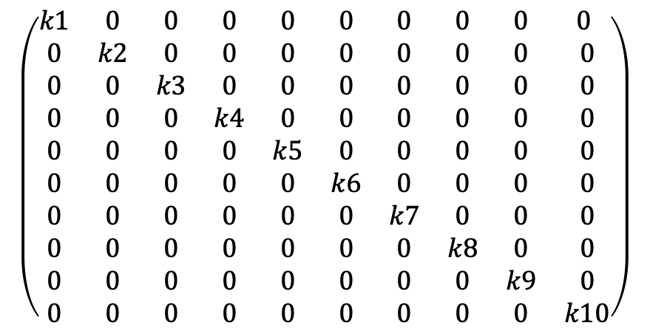
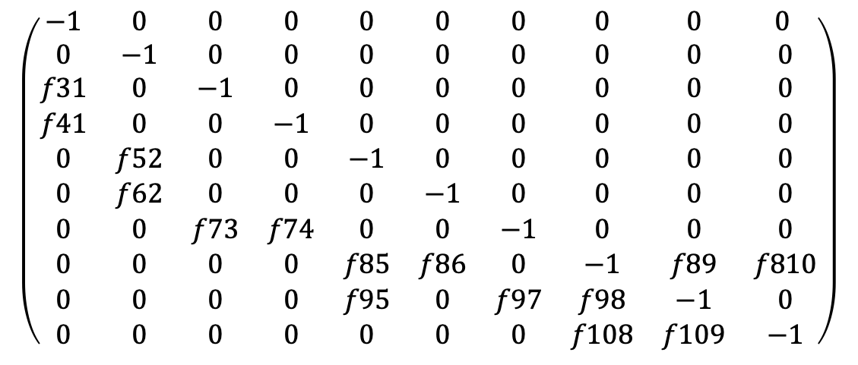
Matrix equation
$$\frac{d}{dx}\left(\begin{aligned}&X1 \\ &X2 \\ &X3 \\ &X4 \\ &X5 \\ &X6 \\ &X6 \\ &X8 \\ &X9 \\ &X10\end{aligned}\right)$$
$$\left(\begin{aligned}1 \\ 2 \\ 0 \\ 0 \\ 0 \\ 0 \\ 0 \\ 0 \\ 0 \\ 0\end{aligned}\right)$$
$$\left(\begin{matrix}−1 & 0 & 0 & 0 & 0 & 0 & 0 & 0 & 0 & 0 \\ 0 & −1 & 0 & 0 & 0 & 0 & 0 & 0 & 0 & 0 \\ f31 & 0 & −1 & 0 & 0 & 0 & 0 & 0 & 0 & 0 \\ f41 & 0 & 0 & −1 & 0 & 0 & 0 & 0 & 0 & 0 \\ 0 & f52 & 0 & 0 & −1 & 0 & 0 & 0 & 0 & 0 \\ 0 & f62 & 0 & 0 & 0 & −1 & 0 & 0 & 0 & 0 \\ 0 & 0 & f73 & f74 & 0 & 0 & −1 & 0 & 0 & 0 \\ 0 & 0 & 0 & 0 & f85 & f86 & 0 & −1 & f89 & f810 \\ 0 & 0 & 0 & 0 & f95 & 0 & f97 & f98 & −1 & 0 \\ 0 & 0 & 0 & 0 & 0 & 0 & 0 & f108 & f109 & −1\end{matrix}\right)$$
=
I
+
$$\left(\begin{matrix}k1 & 0 & 0 & 0 & 0 & 0 & 0 & 0 & 0 & 0 \\ 0 & k2 & 0 & 0 & 0 & 0 & 0 & 0 & 0 & 0 \\ 0 & 0 & k3 & 0 & 0 & 0 & 0 & 0 & 0 & 0 \\ 0 & 0 & 0 & k4 & 0 & 0 & 0 & 0 & 0 & 0 \\ 0 & 0 & 0 & 0 & k5 & 0 & 0 & 0 & 0 & 0 \\ 0 & 0 & 0 & 0 & 0 & k6 & 0 & 0 & 0 & 0 \\ 0 & 0 & 0 & 0 & 0 & 0 & k7 & 0 & 0 & 0 \\ 0 & 0 & 0 & 0 & 0 & 0 & 0 & k8 & 0 & 0 \\ 0 & 0 & 0 & 0 & 0 & 0 & 0 & 0 & k9 & 0 \\ 0 & 0 & 0 & 0 & 0 & 0 & 0 & 0 & 0 & k10\end{matrix}\right)$$
$$\left(\begin{aligned}&X1 \\ &X2 \\ &X3 \\ &X4 \\ &X5 \\ &X6 \\ &X7 \\ &X8 \\ &X9 \\ &X10\end{aligned}\right)$$

